Slide 1
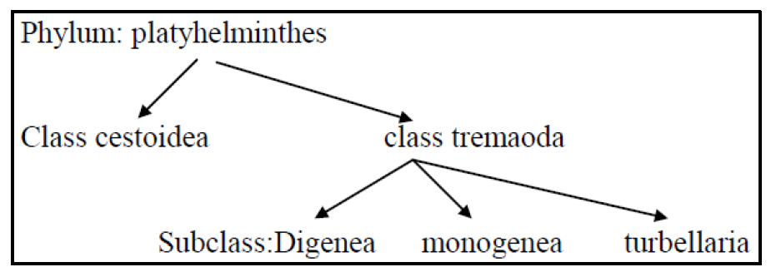
Microbiology Dep.
Second year
Parasitology
10th Lec.
Lecturer: Assist prof.
Dr.Sally Ahmed
(Trematodes)
Class: tremaoda
Subclass: Digenea
Only Digenetic trematoda produce infection in man. Adult trematodes are parasites of vertebrates also called Flukes.
Trematades are hermaphrodites or monocious ,but schistosomes are unisexual(diecious).

Slide 2
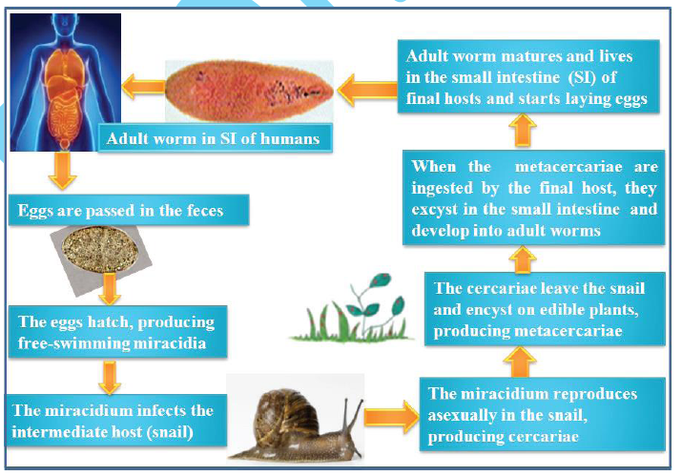
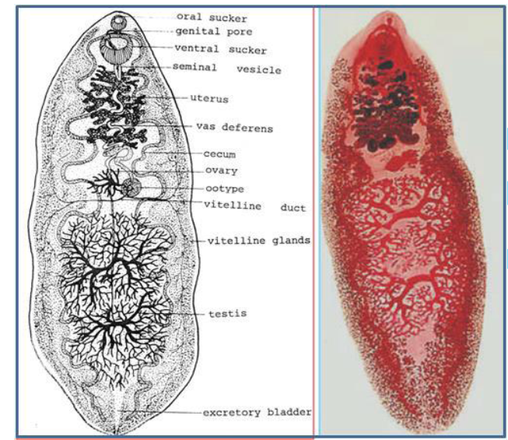
(A) Intestinal flukes
1. Fasciolopsis buski (Giant intestinal fluke infection or fasciolopsiasis)
This giant intestinal fluke is a parasite of central and Southeast Asia (China, Vietnam, Thailand,Indonesia, Malaysia, and the Indian subcontinent). An estimated 10 million infections occureach year. It has not been reported from Iraq.
Life cycle

Slide 3
2. Heterophyes heterophyes (heterophyiasis)
Heterophyiasis is a disease caused by a minute intestinal fluke called Heterophyes heterophyes which is the most common of the 12 species that compose the genus Heterophyes.
Heterophyiasis is more prevalent in the Middle East, in Egypt and in the Far East. Although this disease is more severe in children, it affects both men and women at all ages. The prevalence of heterophyiasis in the Republic of Korea is attributed to the common consumption of brackish water fishes including mullets (Mugil cephalus), perches (Lateolabrax japonicus), and gobies (Acanthogobius flavimanus), in a sashimi style. This disease has not been reported in Iraq
Life cycle
The life cycle of this worm is simple (Figure 3.2b). The eggs are characterized of being embryonated when they are released and contain a fully-developed miracidium. After ingestion by a suitable snail (first intermediate host), the eggs hatch and release miracidia which penetrate
the snail’s intestine. Genera Cerithidia and Pironella are important snail hosts in Asia and the Middle East, respectively.

Slide 4
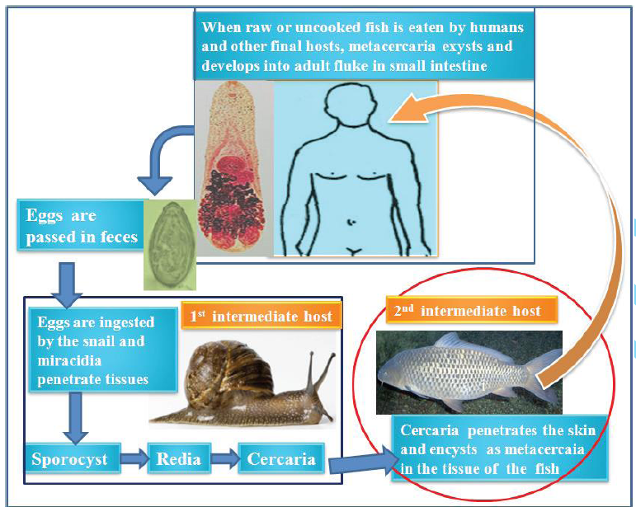
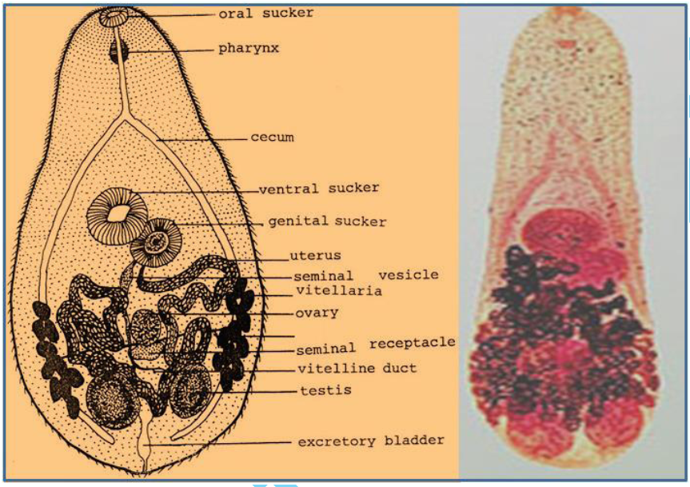

Slide 5
(B) Liver trematodes (flukes)
1. Clonorchis sinensis (Chinese Liver Fluke/ Oriental Liver Fluke)
This parasite is wide spread in humans, dogs and cats in the southeast of Asia, especially China, Korea, Vietnam and Japan. The reservoir hosts for this disease are various freshwater snails, while the vector is usually uncooked freshwater fishes. Related flukes parasitizing European cats(Opisthorchis felinus) and dogs (O. viverini) infect humans in the endemic areas.
Morphology
The adult worm is spindle-shaped and measures about 16 by 4 mm and lives in the biliary ducts. It is a hemaphrodite digenetic fluke with unsegmented, leaf-shaped body. It has two suckers, oraland ventral. The eggs are fully embryonated when laid with a thick, light yellowbrown shell, an operculum with clear opercular shoulders and have a small commashaped appendage at the opercular end. The embryonated eggs are discharged in the biliary ducts and then in the stool

Slide 6
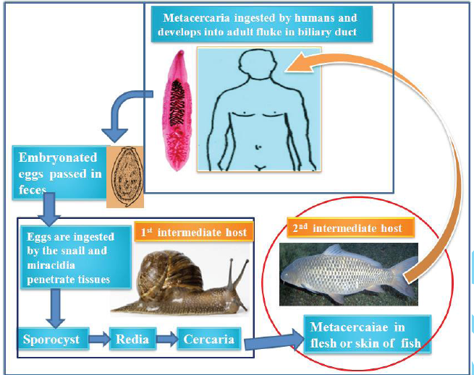
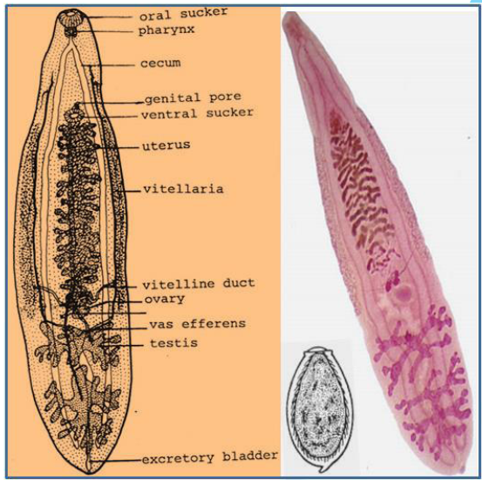
Life cycle
Humans are infected by eating raw or poorly cooked freshwater fish which carries the infective encysted metacercaria. The cyst is digested and the metacercaria migrates up the bile duct to the liver where it matures into an adult worm.

